Slide 1
Lecture 3: K-Means Clustering (because hierarchical clustering is slow)
Dr Matt Wheeler

Slide 2
K-Means
Hierarchical clustering assumes that we know the distance between all observations
For 1000 observations this is ok.
For 100,000,000 observations this is time consuming and memory intensive!
There are 0.5*100,000,000² distances we need to compute!
That equates to approximately 40,000 terabytes of storage!!!
For K-means we say we want K clusters and try to find the K clusters that minimizes this distance.
K*100,000,000 distances << 0.5*100,000,000² distances
K*11 MB << 40,000 TB
hclust() will not run when there are more than 65k observations.

Slide 3
Algorithm:
CLUST <- randomly pick K cluster centroids.
Until Convergence
For Each observation i
Find closest centroid k in CLUST for observation i
Label i with cluster k
Loop
CLUST <- recompute cluster centroids
Loop

Slide 4

Idea: We want to save time so we assume there are K clusters. We start off by throwing out K random cluster centers (i.e. the average d(x,y) for cluster k) then we find the data closest to each cluster, recompute the centroids, and repeat until the centroid center’s don’t change that much. EASY PEASY.

Slide 5
Our Data
This time we are going to look at real data. This comes from the “Knight Foundation Soul of the Community survey.”
This survey looks at a variety of metropolitan areas and attempts looking at community involvement.
Let’s start looking at this assuming a Euclidean distance metric.

Slide 6
The Data
Based upon survey responses.
1 = Low
7 = High
Also have demographic characteristics (Race/Education/Income/Sex etc.)
Messy:
It is not coded the same for every respondent.
Also is a weighted study. We are going to ignore that for the time being.

Slide 7
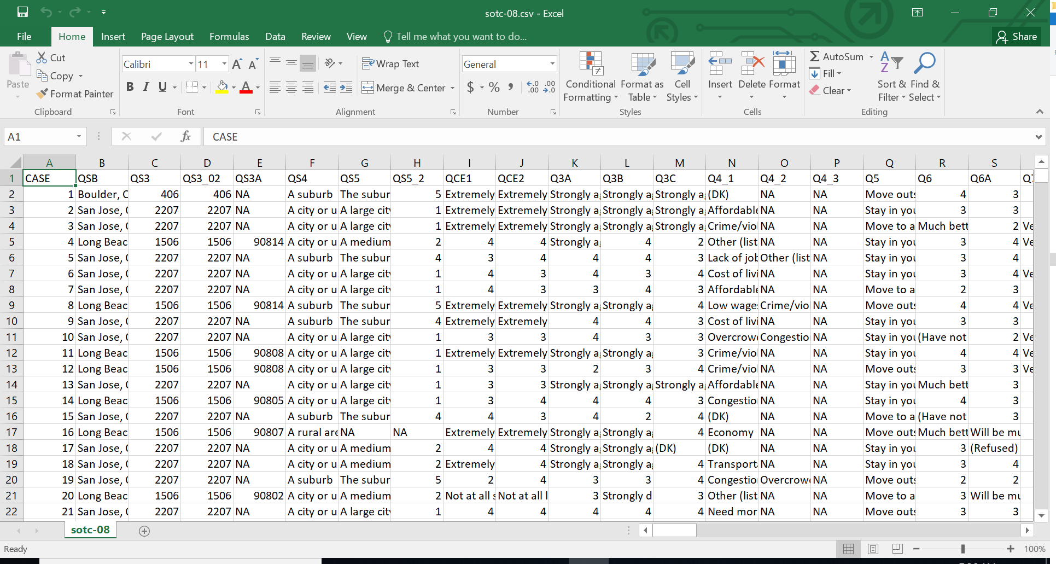

Slide 8
First Find the “optimal” cluster size
df <- scale(df[,-15]) #do this to make everthing mean = 0, sd = 1
reduced.df <- sample_frac(as.data.frame(df),size = 0.10) # randomly sample 10% of the data
# full dataset is too large
fviz_nbclust(reduced.df, kmeans, method = "wss")
fviz_nbclust(reduced.df, kmeans, method = "gap")
fviz_nbclust(reduced.df, kmeans, method = "silhouette")

Slide 9
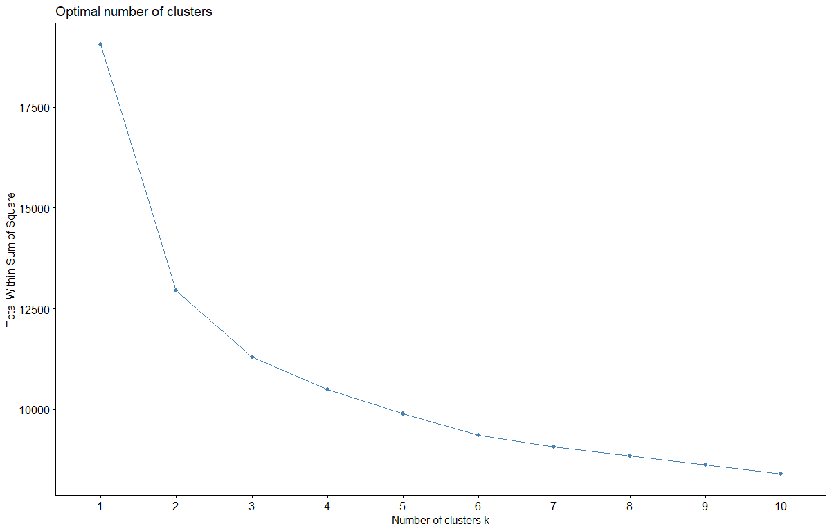
WSS

Slide 10
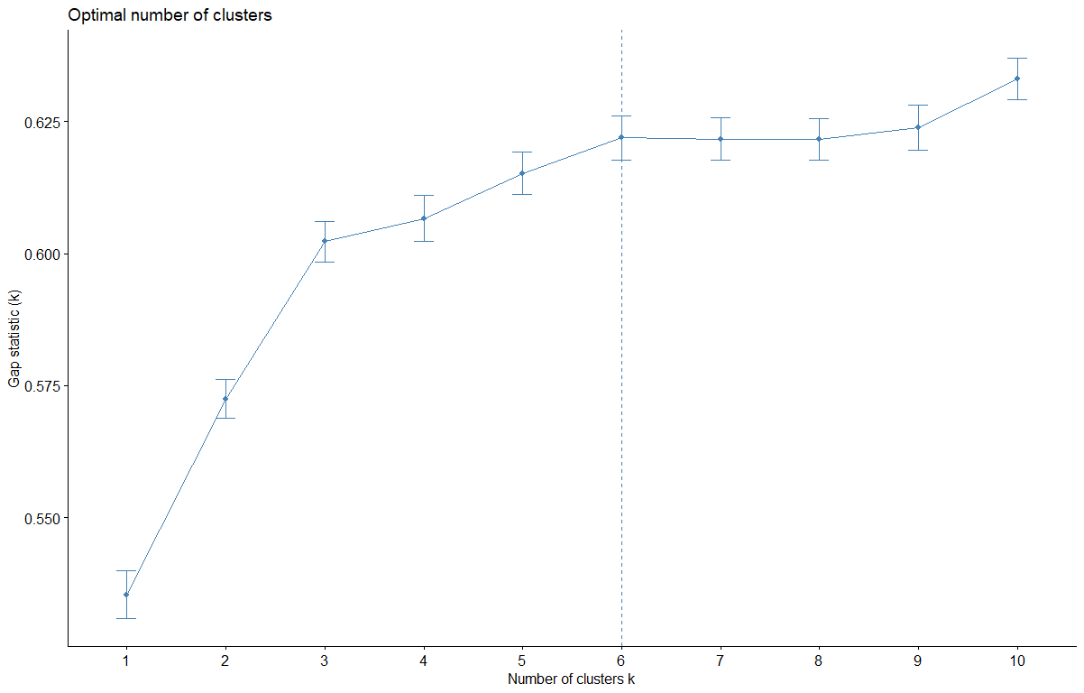
GAP

Slide 11
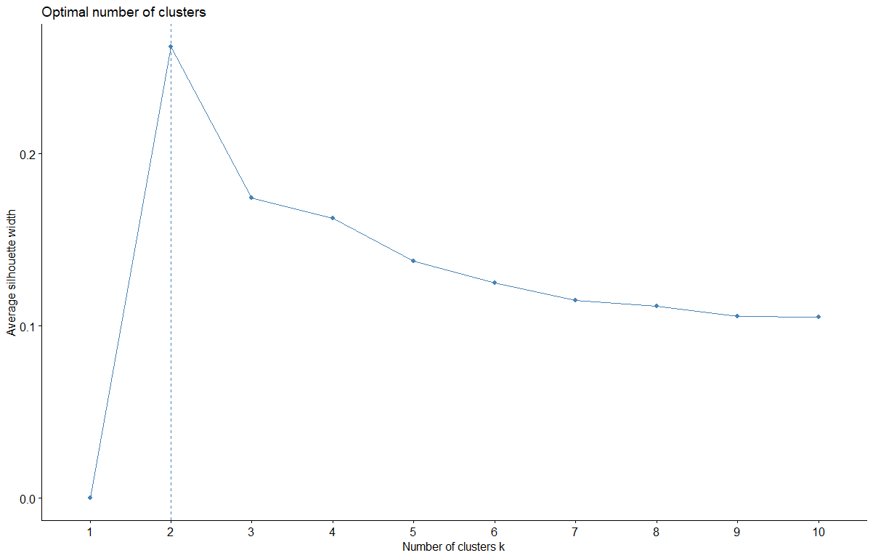
Silhouette

Slide 12
K-Means in R
kmeans(x, centers, iter.max = 10,
nstart = 1,
algorithm =
c("Hartigan-Wong", "Lloyd",
"Forgy", "MacQueen"),
trace=FALSE)
Number of random centers
Data

Slide 13
I have clusters, what do I do with them.
Chances are your boss isn’t going to ask you to “find” some clusters and be done. Segmentation is about trying to understand the differences, so you can tell your boss something useful.
THIS IS AN ART!!!

Slide 14
What would you say about these centroids?
LOYALTY | PASSION | CCE | LEADERSH | EDUCATIO | SAFETY | AESTHETI
-1.10 | -1.13 | -1.18 | -0.60 | -0.76 | -0.41 | -0.83
0.20 | 0.27 | 0.25 | -0.20 | -0.03 | -0.02 | 0.04
0.88 | 0.79 | 0.88 | 1.00 | 0.90 | 0.48 | 0.85
INVOLVEM | OPENNESS | SOCIAL_C | DOMAINS | ECONOMY | SOCIAL_O | COMMUNITY
-0.20 | -0.77 | -0.34 | -0.85 | -0.57 | -0.80 | -0.98
0.03 | -0.12 | 0.04 | -0.06 | -0.14 | -0.09 | -0.11
0.17 | 1.05 | 0.30 | 1.03 | 0.86 | 1.03 | 1.26

Slide 15

“I love this place”

Slide 16

The “MEH” group

Slide 17

“I gotta get outa here”

Slide 18
What can we say about these groups?
Just naming these groups is one thing. Can we use these ‘labels’ to know anything about our groups.
That is can we look at information not used in the cluster analysis (demographic etc.)
Here: Cluster 1 = BAD, 2 = Meh, 3 = “Yeah”

Slide 19
Probability of Falling in each cluster
| clust| n| prop|
|-----:|----:|---------:|
| 1| 3928| 0.2920880|
| 2| 5966| 0.4436347|
| 3| 3554| 0.2642772|

Slide 20
With regard to wages
|wage | clust| n| prop|
|:------------------|-----:|----:|---------:|
|$100,000 or over | 1| 708| 0.2401628|
|$100,000 or over | 2| 1425| 0.4833786|
|$100,000 or over | 3| 815| 0.2764586|

Slide 21
|wage | clust| n| prop|
|:------------------|-----:|----:|---------:|
|Under $15,000 | 1| 248| 0.3568345|
|Under $15,000 | 2| 251| 0.3611511|
|Under $15,000 | 3| 196| 0.2820144|

Slide 22
What about Race?
|race | clust| n| prop|
|Asian (If necessary, read:) includes Chinese, Filipino... | 1| 82| 0.2827586|
|Asian (If necessary, read:) includes Chinese, Filipino... | 2| 149| 0.5137931|
|Asian (If necessary, read:) includes Chinese, Filipino... | 3| 59| 0.2034483|
|Black or African-American | 1| 510| 0.3635068|
|Black or African-American | 2| 545| 0.3884533|
|Black or African-American | 3| 348| 0.2480399|
|White | 1| 2945| 0.2764999|
|White | 2| 4817| 0.4522580|
|White | 3| 2889| 0.2712421|

Slide 23
Education?
|edu | clust| n| prop|
|:--------------------------------|-----:|----:|---------:|
|Post-graduate work or degree | 1| 769| 0.2556516|
|Post-graduate work or degree | 2| 1434| 0.4767287|
|Post-graduate work or degree | 3| 805| 0.2676197|
|Some high school | 1| 164| 0.3147793|
|Some high school | 2| 184| 0.3531670|
|Some high school | 3| 173| 0.3320537|

Slide 24
???
So how can we name these “groups” now that we know more about them?
Are there other questions you can ask about the data?

